Slide 1


SAINIK PUBLIC SCHOOL BARABANKI GK QUIZ COMPETITION (VI To VIII)
May 10 ,
2025

Slide 2
ROUND – 1 (Question Round)

Slide 3
ARE YOU READY ?

Slide 4
Q1. What is the capital of Japan?

Slide 5
Q2. What is the name of the device that converts chemical energy into electrical energy?

Slide 6
Q3. Which is the smallest country in the world?

Slide 7
Q4. Who was the author of AIN-I-AKBARI ?

Slide 8
Q5. Which instrument is used to measure atmospheric pressure?

Slide 9
Q6. Which country is home to the Eiffel Tower?

Slide 10
Q7.World environment day is celebrated on which day?

Slide 11
Q8. Pongal is the festival of which state?

Slide 12
Q9. What is the smallest unit of data in a computer?

Slide 13
Q10. The Great Bath was found at which Indus valley civilization?

Slide 14
ROUND – 2 (Picture Round)

Slide 15
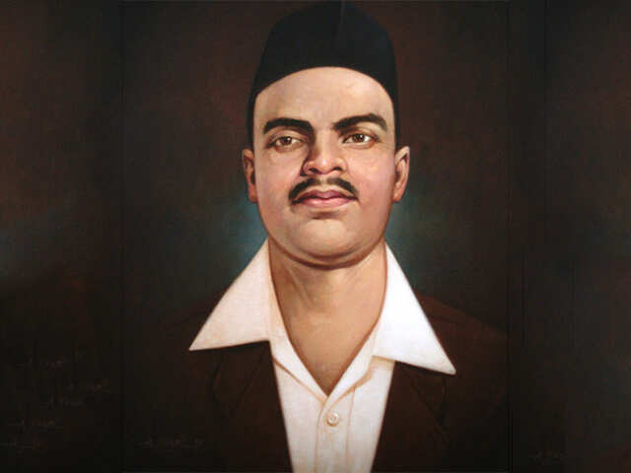
Q1.Who is the freedom fighter in this picture?

Slide 16
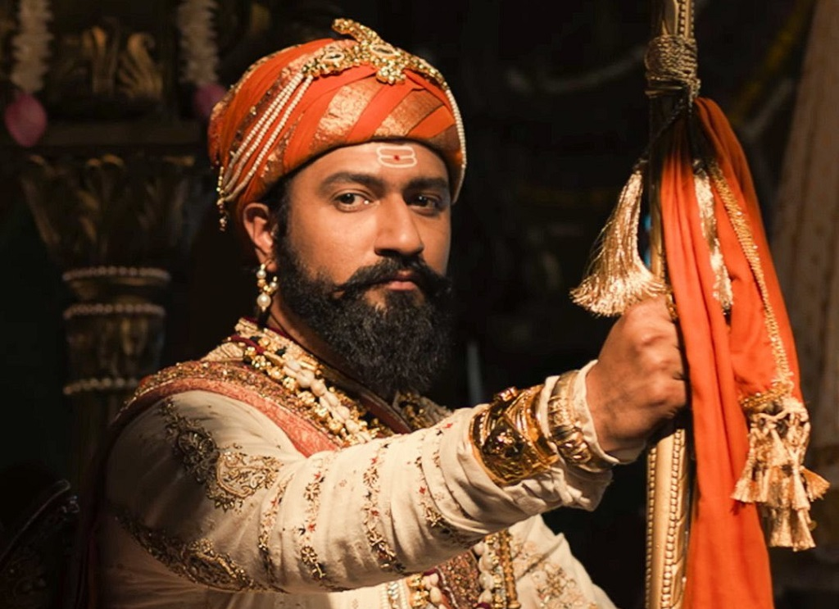
Q2.He is the famous character of movie Chhava?

Slide 17
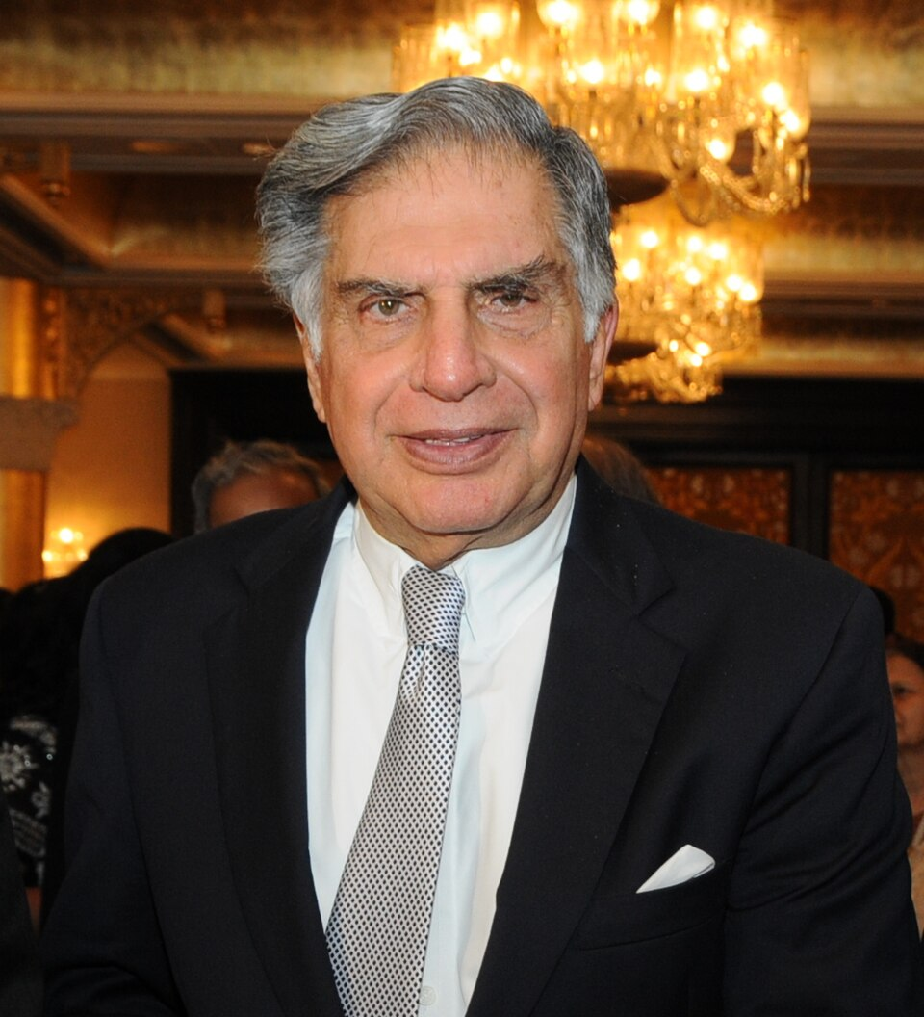
Q3. Identify this famous industrialist ?

Slide 18
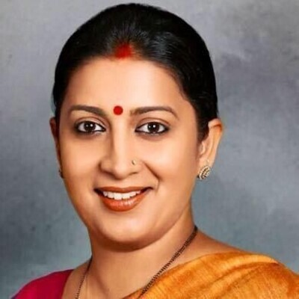
Q4. Identify the famous political personality, former actress and television producer?

Slide 19
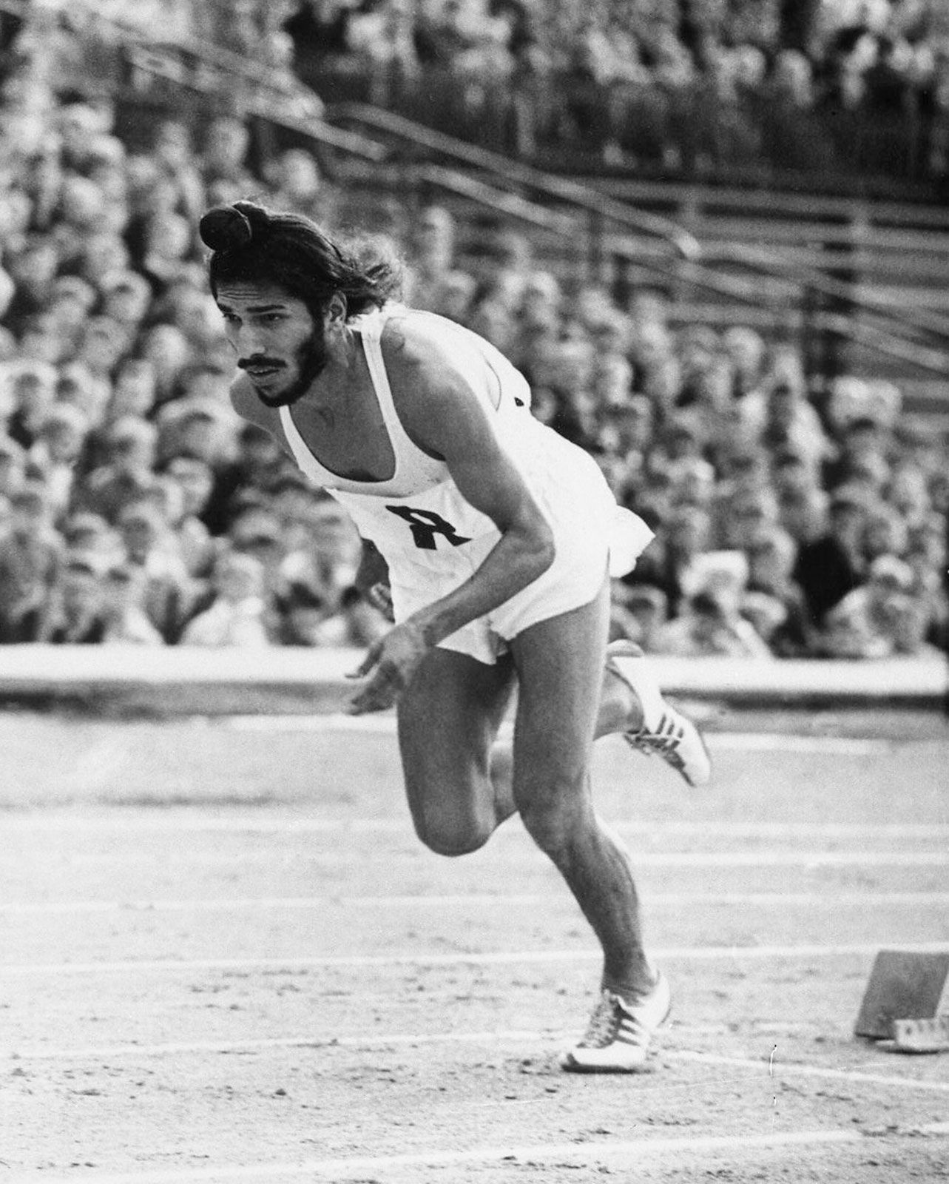
Q5. Identify this famous athletic personality, Biopic is also made on this personality?

Slide 20
FINAL ROUND
Riddle Round

Slide 21
I am white when, I am dirty and Black when I am clean, What am I ?

Slide 22
I have cities , but no houses , I have forests , but no trees , I have water but no fish . Who am I ?

Slide 23
What starts with a ‘P’ ends with an ‘E’ and has thousands of letters?

Slide 24
THANK YOU

